Slide 1
Random Access Files

Slide 2
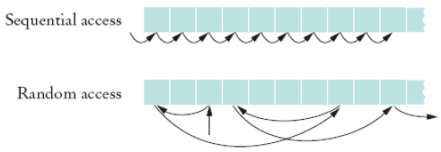
Random Access Files
Random access files are files in which records can be accessed in any order
  Also called direct access files
  More efficient than sequential access files

Slide 3
Need for Random Access Files
Real-time applications require immediate response
  Example: respond to customer query about a bill
  Sequencing through records for account is time-intensive
Random (immediate) access meets real-time need
  Directly read from or write to desired record

Slide 4
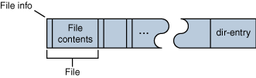
Example
Consider the zip format. A ZIP archive contains files and is typically compressed to save space. It also contain a directory entry at the end that indicates where the various files contained within the ZIP archive begin

Slide 5
Accessing a specific file using sequential access
Open the ZIP archive.
Search through the ZIP archive until you locate the file you want to extract.
Extract the file.
Close the ZIP archive.
On an average, we have to read half of the zip archive to find the required file

Slide 6
Accessing a specific file using random access
Open the ZIP archive.
Seek to the directory entry and locate the entry for the file you want to extract from the ZIP archive.
Seek (backward) within the ZIP archive to the position of the file to extract.
Extract the file.
Close the ZIP archive.
This is more efficient as you read only the directory entry and file that you want to extract.

Slide 7
RandomAccessFiles class
The RandomAccessFile class contains the same read(), write() and close() methods as Input and OutputStream
Also contains seek() that lets you select a beginning position within the file before reading or writing data
Includes capabilities for reading and writing primitive-type values, byte arrays and strings

Slide 8
RandomAccessFile Class
NOT compatible with the stream/reader/writer models
With a random-access file, you can seek to the desired position and then read and write an amount of bytes
Only support seeking relative to the beginning of the file
  Not relative to current position of file pointer
  However there are methods that report the current position

Slide 9
Methods to support seeking
long getFilePointer()
Returns the current offset in this file.
long length()
Returns the length of this file.
void seek(long pos)
Sets the file-pointer offset, measured from the beginning of this file, at which the next read or write occurs.

Slide 10
Constructor Summary
RandomAccessFile(File file, String mode)
Creates a random access file stream to read from, and optionally to write to, the file specified by the File argument.
RandomAccessFile(String name, String mode)
Creates a random access file stream to read from, and optionally to write to, a file with the specified name.
The mode should be either “r” or “rw”
  No “w”

Slide 11
Constructor Summary
When a RandomAccessFile is created in read-only mode a FileNotFoundException is generated
When a RandomAccessFile is created in read-write a zero length file will be created

Slide 12
File Pointer
RandomAccessFile supports file pointer which indicates the current location in the file. When the file is first created, the file pointer is set to 0, indicating the beginning of the file. Calls to the read and write methods adjust the file pointer by the number of bytes read or written.

Slide 13
Manipulate file pointer
RandomAccessFile contains three methods for explicitly manipulating the file pointer.
int skipBytes(int) — Moves the file pointer forward the specified number of bytes
void seek(long) — Positions the file pointer just before the specified byte
long getFilePointer() — Returns the current byte location of the file pointer

Slide 14
To move the file pointer to a specific byte
f.seek(n);
To get current position of the file pointer.
long n = f.getFilePointer();
To find the number of bytes in a file
long filelength = f.length();

Slide 15
Writing Example
import java.io.*;
public class RandomAccess {
public static void main(String
args[]) throws IOException {
RandomAccessFile myfile = new RandomAccessFile("rand.dat", "rw");
myfile.writeInt(120);
myfile.writeDouble(375.50);
myfile.writeInt('A'+1);
myfile.writeBoolean(true);
myfile.writeChar('X');

Slide 16
// set pointer to the beginning of file and read next two items
myfile.seek(0);
System.out.println
(myfile.readInt());
System.out.println
(myfile.readDouble());
//set pointer to the 4th item and read it
myfile.seek(16);
System.out.println

Slide 17
0
(myfile.readBoolean());
// Go to the end and “append”
an integer 2003
myfile.seek(myfile.length());
myfile.writeInt(2003);
// read 5th and 6th items
myfile.seek(17);
System.out.printlna
Int
4
Double
12
Int
16
boolean
17
Char
19
Int
23

Slide 18
(myfile.readChar());
System.out.println
(myfile.readInt());
System.out.println("File length: "+myfile.length());
myfile.close();
}
}

Slide 19
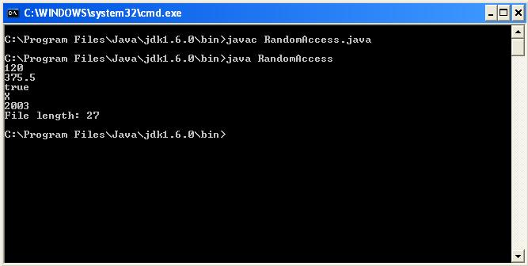
Output

Slide 20
Reading Example
RandomAccessFile creates random access files
  Contains familiar read( ), write( ), open( ), close( )
  seek( ) method selects start position within a file before read or write
  Places a file pointer at the selected location
  File pointer holds byte number of next file position
  Ex: locate 32nd character in file, which may then be read

Slide 21
Reading Example
import java.io.*;
public class AccessCharacter
{
public static void main(String[] args) throws IOException
{
OutputStream ostream;
int c;
RandomAccessFile inFile = new RandomAccessFile("AQuote.txt","r");
ostream = System.out;
int pos = 32;

Slide 22
try
{ inFile.seek(pos);
c = inFile.read();
System.out.print("The character in position " + pos + " is ");
ostream.write(c);
}a
catch (IOException e)
{ System.out.println();
inFile.close();
ostream.close();
}
}
}

Slide 23
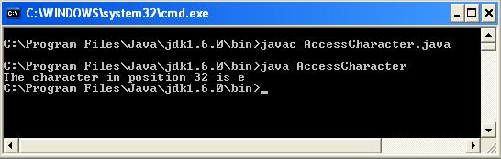
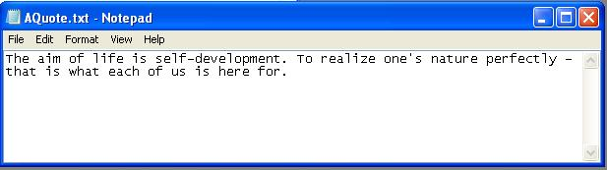
Output

Slide 24
References
Object Oriented Software Development using Java- 2nd edition - Xiaoping Jia
Java Programming 3rd edition – Joyce Farrell
www.java.sun.com
www.javaworld.com

